Slide 1
OPERATIONS – A Starter Kit
A few basic elements to start operations on your model railroad.
Bruce Bowie, Div 4, MCR, NMRA

Slide 2
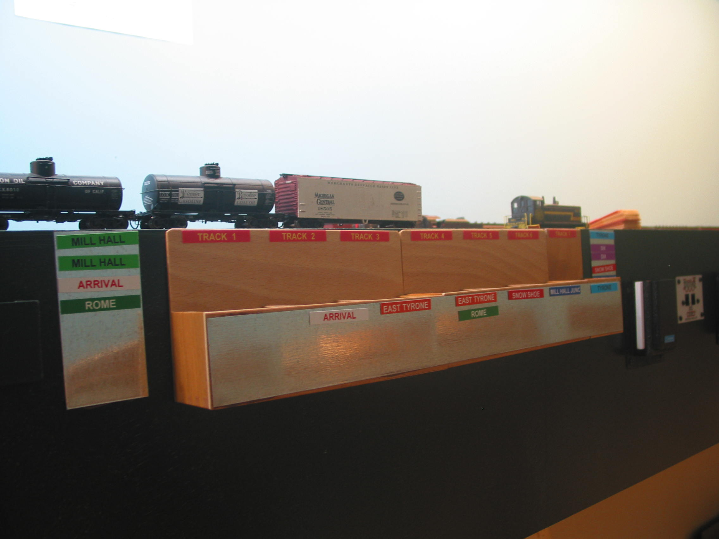
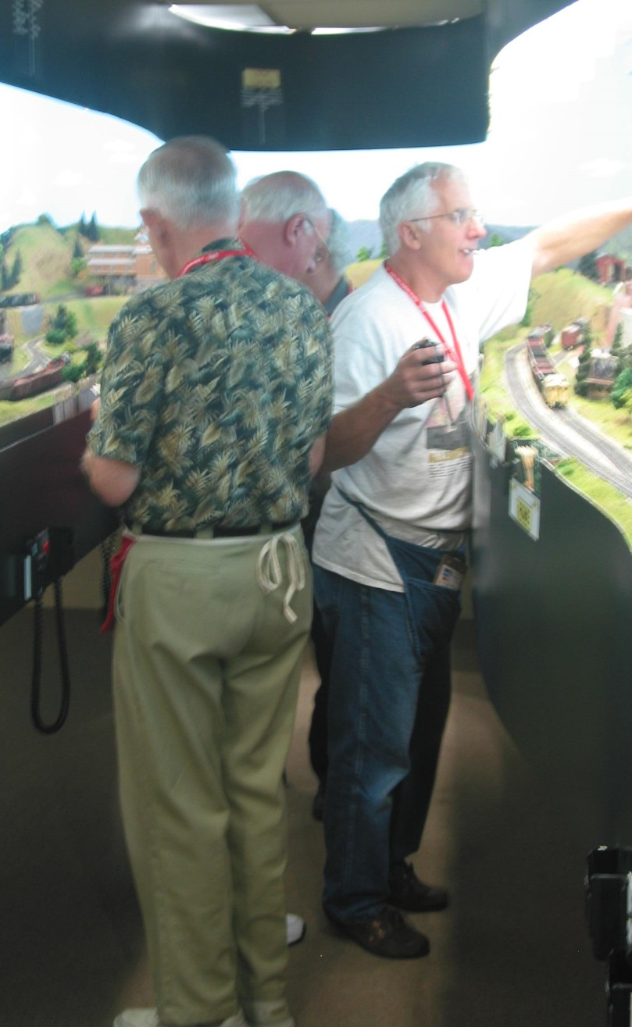
Target audience - members who have heard of, but never operated their model railroad
There are many types of operating systems from very simple to highly complex, totally manual to sophisticated computer controlled. The goal of this clinic is to show members a simple way to initiate operations on their home layouts and point them towards the necessary tools to give it a try.

Slide 3
OPERATIONS – A Starter Kit
Why “Operate” Your Model Railroad?
Train Movement vs Car Forwarding
Basic Materials Needed for a Car Card Operating System
Car Cards
Waybills
Where Do I Start??
Set Out, Hold, Pick Up, Huh?
Ready, Set, GO!
Some Tools To Get You Going
MS-Access Car Card File
MS-Excel Waybill File
A Non-computer Way To Go
Miscellaneous Items
Tips and Tricks
A Special Offer To You Lucky Dogs!
WARNING

Slide 4
Why “Operate” Your Model Railroad?
Operations provide an ongoing purpose or use for your model railroad
Operations can be done on layouts of any size
Model railroads designed for operations often have a more prototypical design
Designing a model railroad for operations and operating it can be mentally stimulating
Operating can be a social event for two or more operators
Operating is FUN!

Slide 5
Train Movement vs Car Forwarding
TRAIN MOVEMENT
TT&TO (Time Table & Train Order
Track warrants
ABS
CTC
“Mother may I?”
CAR FORWARDING
Tab/sticker on car
Car Cards
Ship It
Rail OP
JMRI Operations
Switch Lists

Slide 6
Basic Materials Needed for a Car Card Operating System
Car cards
  Shipping tape to make waybill pocket
Way bills
Three position boxes (Set Out / Hold / Pickup)

Slide 7
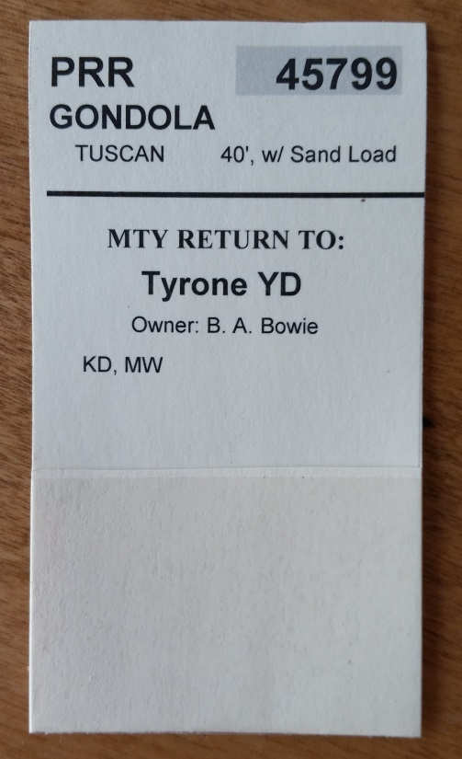
Car Cards
Car cards made from card stock with pocket for waybills
  Typical HP printer will print on 60# card stock
Information includes
  Owning road
    Often abbreviated
  Car number
  Car type
    AAR designation, or plain English
      Example: XM, or Boxcar
  Car color
  Length

Slide 8
Car Cards
Other information sometimes included:
  When Empty Return TO:
  Owner
  Miscellaneous
    Coupler type
    Metal wheels
Different color card stock may be used to denote car type
  Freight, passenger, MOW, Locomotive

Slide 9
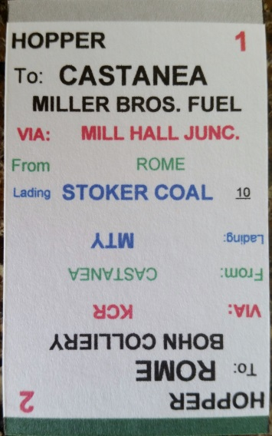
Waybills
Classic waybills include 4 moves, numbered 1-4 (duh!)
Waybills may also be two moves
  Example: Move 1 - coal mine to power plant, Move 2 – power plant to coal mine
Waybills are positioned in car card showing current move number
Information shown includes:
  Car Type, ‘Destination’ Town, ‘Destination’ Industry, Commodity, ‘Via’ Location, Color Stripe indicating next destination

Slide 10
Where Do I Start??
To determine APPROXIMATELY how many cars you need to operate your railroad:
  100% fill each industry spur mixing car types as used by given industry
Make waybills for each car
  Consider likely movement from industry to industry on your own railroad
  Also consider movement to and from industries on your railroad to and from locations “beyond” the extents of your railroad
  May be two move or four move (using 2-sided waybills)

Slide 11
Where Do I Start??
Make car cards for each car
Place waybill in each car with current location showing on top of waybill
Move 1/3 of cars and respective car cards/waybills from industry spurs to staging and/or marshalling yards
  Place these car cards in PICK UP box
Change waybill for 1/3 of car cards still at industry to next move
  Place these car cards in PICKUP box
Final 1/3 of car cards at industry are placed in HOLD box
Add cars in staging and/or marshalling yards until 50% full
    Additional cars may be passenger cars and/or cars used to makeup through freight trains
  Too many cars will clog the railroad

Slide 12
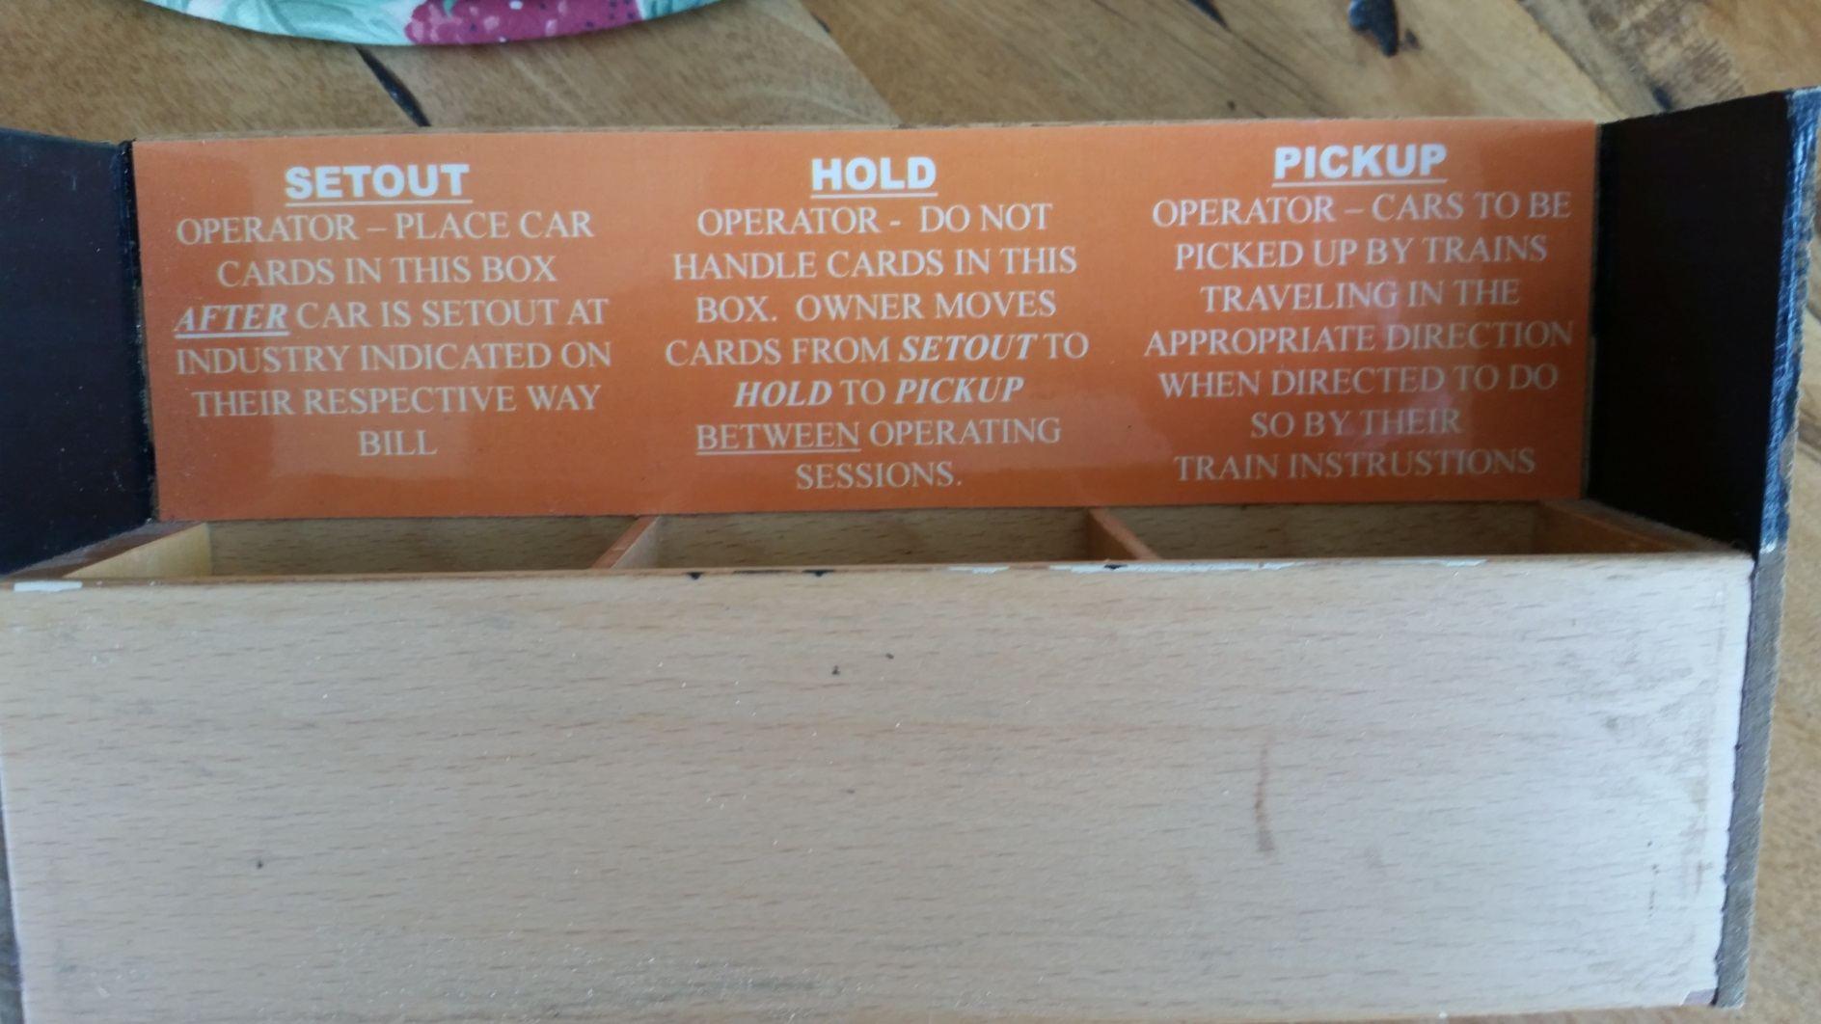
Set Out, Hold, Pick Up, Huh?

Slide 13
Set Out, Hold, Pick Up, Huh?
SETOUT – Operator places car card w/ waybill in this box after placing car in designated setout location. Waybill not changed at this point.
HOLD – Operator does not touch these cards…….OWNER moves cards from SETOUT to HOLD between operating sessions
PICKUP – Operator picks up cars with car cards in this box AND going in the same direction of travel as his train.
OWNER after session moves cards from SET OUT to HOLD and from HOLD to PICKUP (moving waybill to next position: Move 1 to Move 2, Move 2 to Move 3, etc.)

Slide 14
Ready, Set, GO!
With 1/3 cars in yards with car cards in PICK UP, 1/3 at industry with car cards in HOLD and 1/3 in PICK UP, you are ready to operate
Make up a train to move cars from a yard, taking the car cards for each car in the train
As the train moves across the layout, drop off cars for industries as noted on car cards in your train.
Pick up cars at industries for cars going same direction as your train
  Trains often have maximum number of cars and if reached, simply continue across layout without picking up more cars and dispatch another train for additional pickups

Slide 15
Some Tools To Get You Going
Make your own Car Cards using MS-Access (original file by David Husman)
Make your own Waybills using MS-Excel (original file developed by Wolfgang Dudler, modified for color coded stripe by Bruce Bowie with big assist from Dennis Whitaker and his friend in Colorado, name unknown)
  Excel must be 2007 or newer to support conditional formatting, used for color coded strip at top of each position
Files available on Div 4 website
  Price: FREE!
Buy car card & waybill “kit” from Micro-Mark

Slide 16
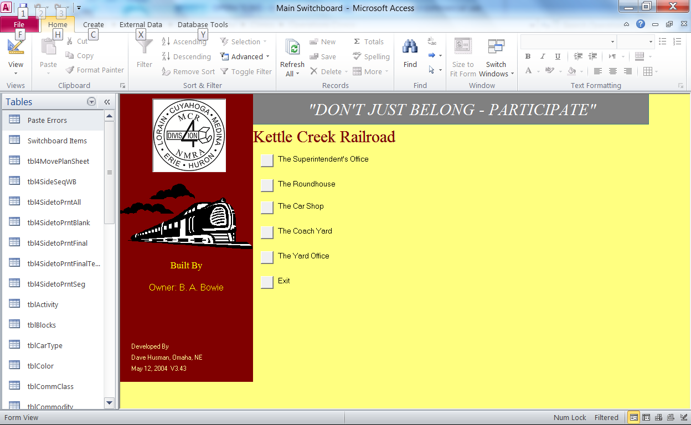
MS-Access Car Card File
Click on THE SUPERINTENDENT’S OFFICE
then click on QUICK START
Print and follow for initial setup

Slide 17
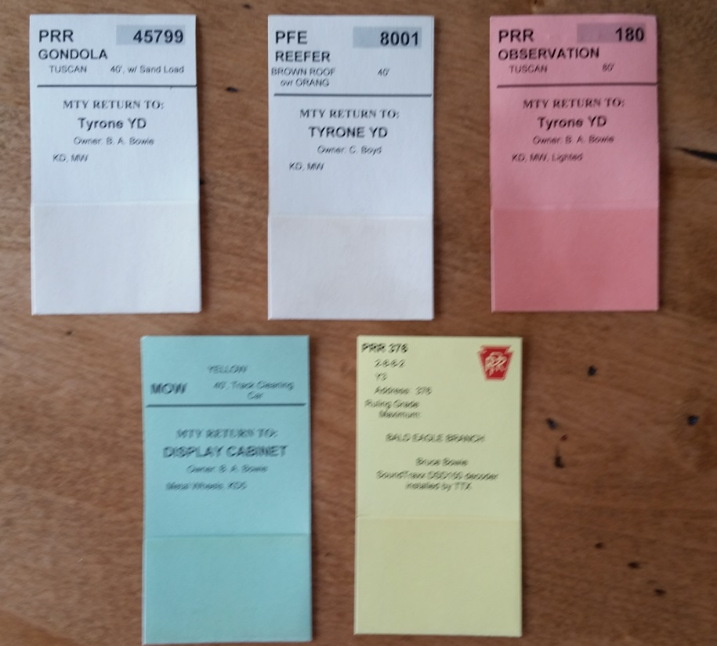
MS-Access Car Card File
NOTE: This Access file also supports making waybills. I have not utilized this function and cannot speak to its pros and cons

Slide 18
MS-Access Car Card File

Slide 19
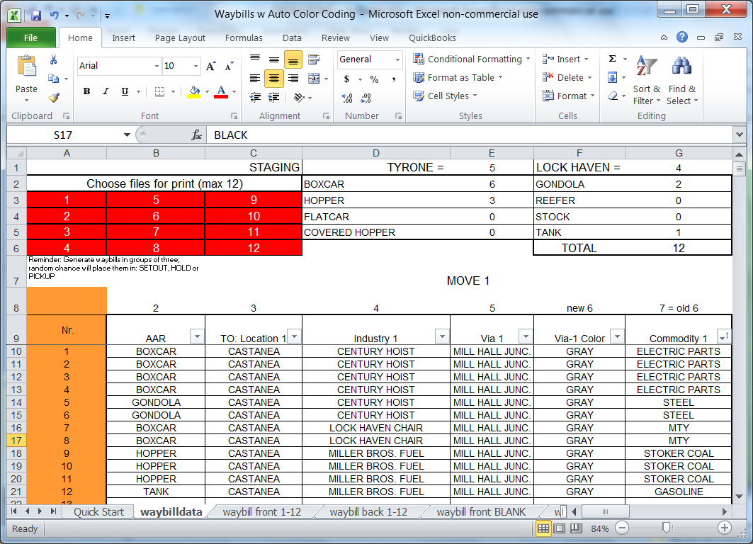
MS-Excel Waybill File
Click on QUICK START tab then
print and follow for initial setup

Slide 20
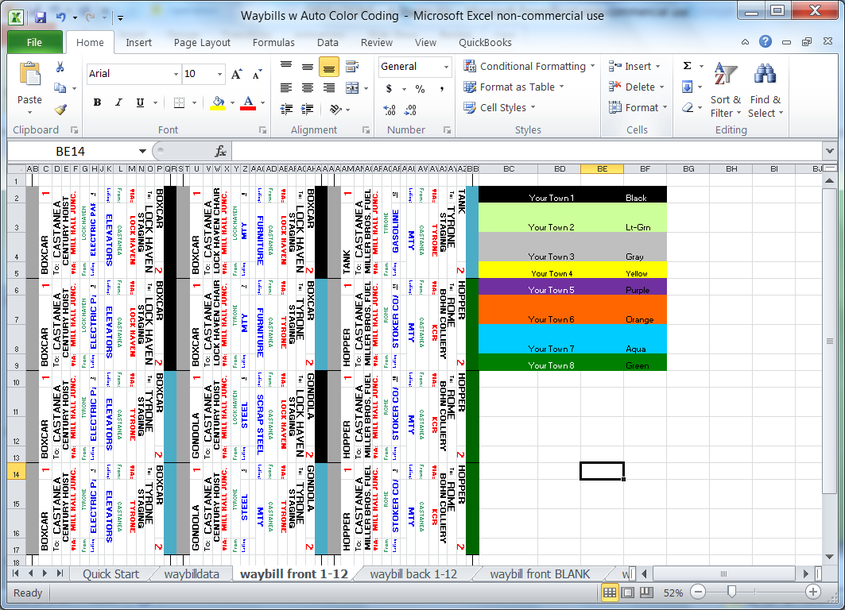
Waybill Spreadsheet

Slide 21
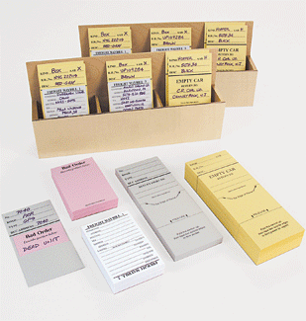
A Non-computer Way To Go
Micro-Mark sells a starter kit for $33.³⁰
  #82916 Car Routing System Starter Pack includes: 100 each car cards, waybills, and bad order slips, 25 locomotive cards, 4 three-compartment bill boxes, plus basic instructions to get your operations started.
NEAT PRINTING HIGHLY RECOMMENDED

Slide 22
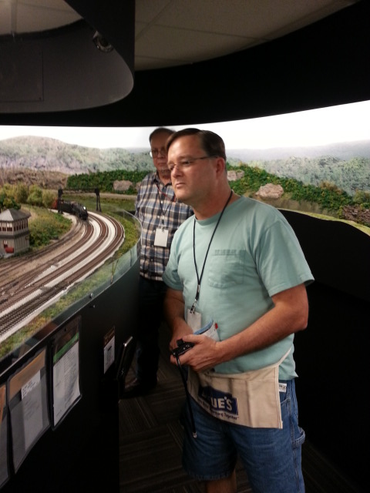
Tips and Tricks
Binder clips to hold car cards
Small flashlight to assist operators reading car numbers
Uncoupling pics if not using magnets
Track schematic w/ town names and direction, E/W
Apron to hold above

Slide 23
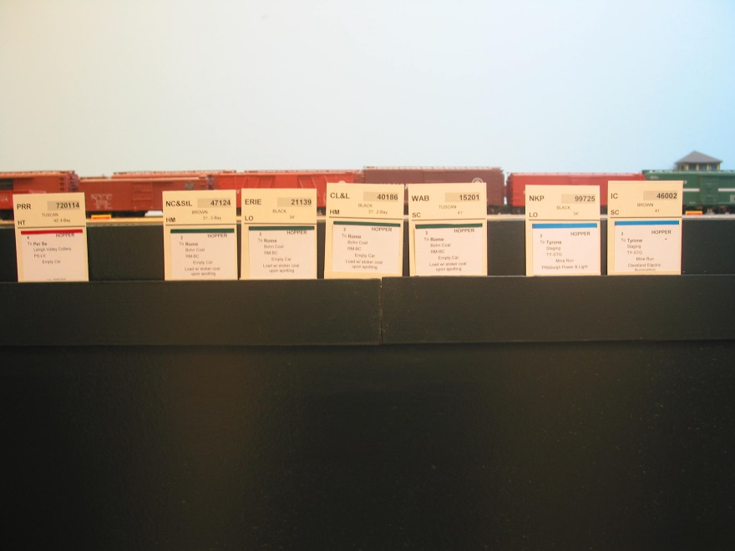
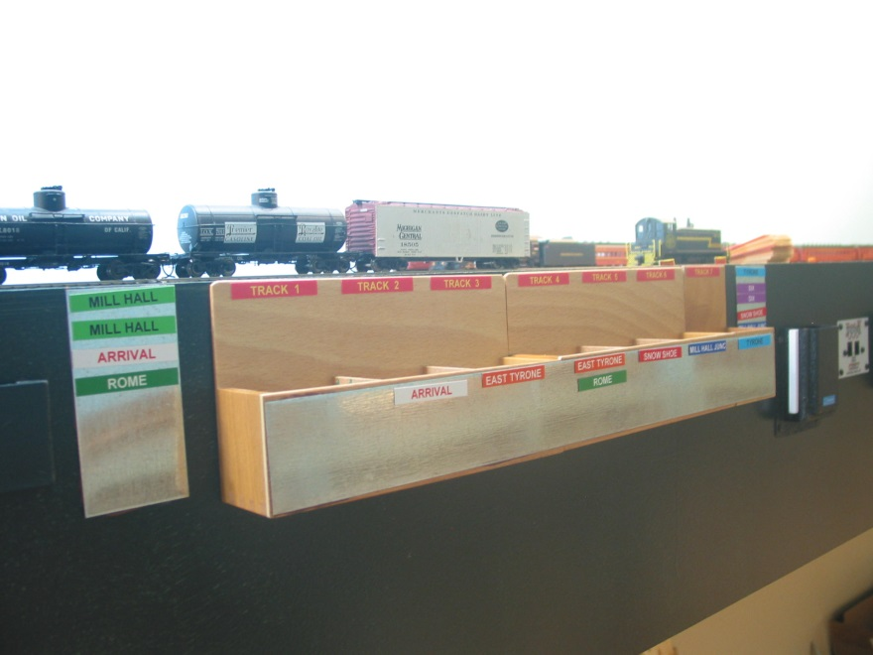
Tips and Tricks
Card sorting trays
Yard boxes
  Color coded magnetic labels
Use dividers in boxes where multiple industries in a town
Single box with dividers for SETOUT/HOLD/PICK UP at small town or single industry
Reduced depth boxes and/or install inside fascia in narrow aisles

Slide 24
A Special Offer To You Lucky Dogs!
Division 4 members Bruce Brintnall, MMR and Joe Filipiak are offering to arrange operating sessions for newbies this summer. Both railroads utilize different operating schemes and both provides loads of fun. Contact Bruce and Joe to participate in this opportunity.

Slide 25
WARNING!
The Surgeon General has found the properties making up Operating A Model Railroad to be highly addictive. Operate at your own risk!

